Slide 1
Cyber Threat Hunting
CTH 101

Slide 2
Agenda
Pyramid of Pain
Overview of Hunt Methodologies
Signature-based Hunting
Threat Intelligence-based Hunting
Behavior-based Hunting

Slide 3
Cyber Threat Hunting – Pyramid of Pain
@paladin3161

Slide 4
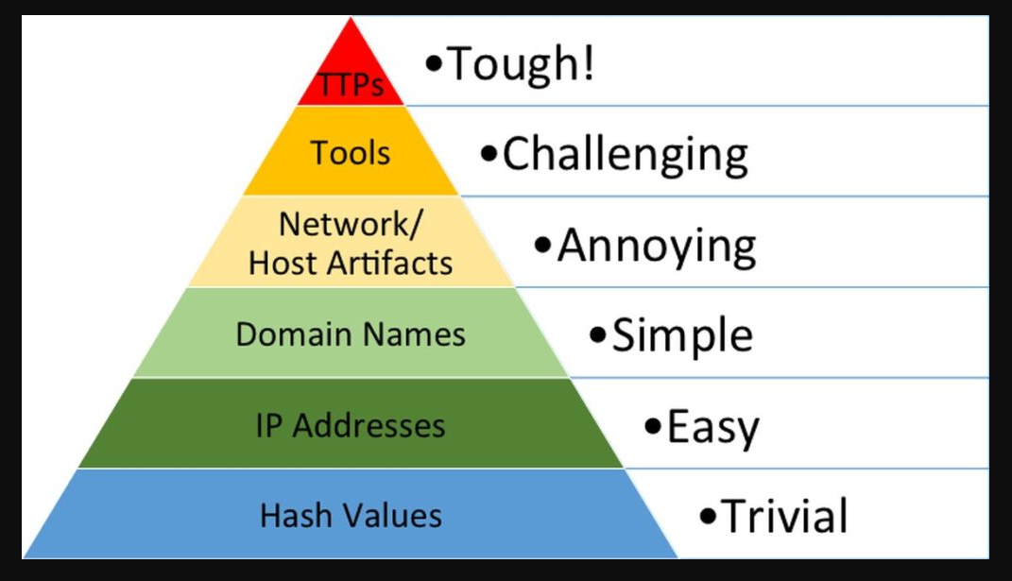
Cyber Threat Hunting – Pyramid of Pain
@paladin3161
David Bianco – Pyramid of Pain

Slide 5
Cyber Threat Hunting Methodologies
@paladin3161

Slide 6
Cyber Threat Hunting Methodologies What is Cyber Threat Hunting (CTH)?
What is Cyber Threat Hunting (CTH)?
Threat Hunting Methodologies
Signature-based Hunting
Threat intelligence-based Hunting
Behavior-based Hunting
Notes:
Threat hunting is a proactive approach to cybersecurity that involves actively searching for threats within an organization's network or systems. Hunting for activity and behaviors that are not currently detected or alerted by Security Tools.

Slide 7
Cyber Threat Hunting Methodologies What is Signature-based Hunting?
What is Signature-based Hunting?
Advantages of signature-based hunting
Easy to implement
Effective against known threats
Can be automated
Limitations of signature-based hunting
Ineffective against new or unknown threats
Can produce many false positives or false negatives
Requires frequent updates to keep up with new threats
Notes:
Signature-based hunting is a methodology that involves searching for known threats based on their unique signatures or patterns. These signatures are often generated by antivirus software or threat intelligence feeds. Signature-based hunting is useful for detecting known malware and other threats that have been previously identified.

Slide 8
Cyber Threat Hunting Methodologies What is Threat intelligence-based Hunting?
What is Threat intelligence-based Hunting?
Advantages of threat intelligence-based hunting
Effective at identifying emerging threats
Provides context and background information on threats
Can be used to identify vulnerabilities in the organization's systems
Limitations of threat intelligence-based hunting
Requires access to reliable sources of threat intelligence
Can be time-consuming to sift through large amounts of information
May not provide a complete picture of the organization's security posture
Notes:
Threat intelligence-based hunting involves using external sources of information to identify potential threats. This may include threat intelligence feeds, open-source intelligence, or information shared within the cybersecurity community. Threat intelligence-based hunting can be used to identify emerging threats and vulnerabilities.

Slide 9
Cyber Threat Hunting Methodologies
What is Behavior-based Hunting?
Advantages of behavior-based hunting
Advanced Hunt Techniques
Effective against new or unknown threats
Can lead to high confidence detections
Demonstrate proof of value
Can leverage multiple hunts together
Limitations of behavior-based hunting
Can produce false positives if legitimate activity is flagged as suspicious
Requires a baseline of normal behavior to identify deviations
Can be time consuming/requires a lot of testing to get it right
Notes:
Behavior-based hunting involves looking for unusual or suspicious activity on the network or systems. Behavior-based hunting can be used to detect new or unknown threats that may not have a known signature.

Slide 10
Cyber Threat Hunting Methodologies Behavior-based Hunting – Demo Video
@paladin3161

